Slide 1

Good morning to all

Slide 2
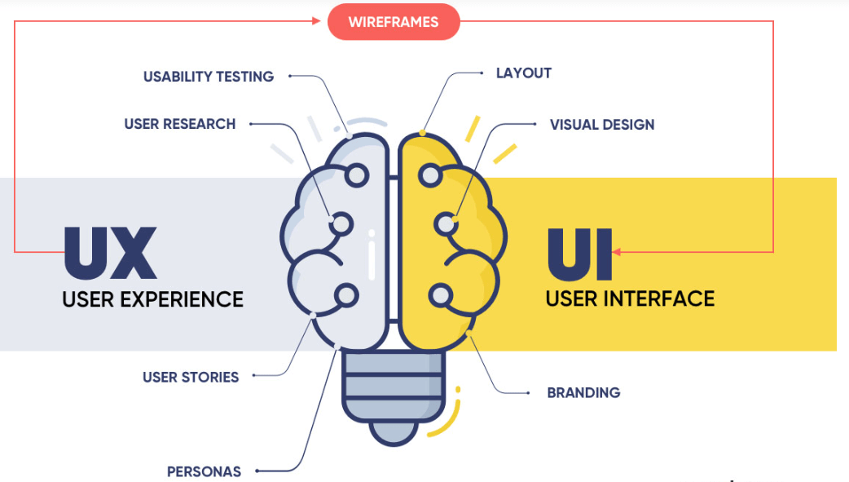
UX VS UI
presented by KARTHEISH

Slide 3
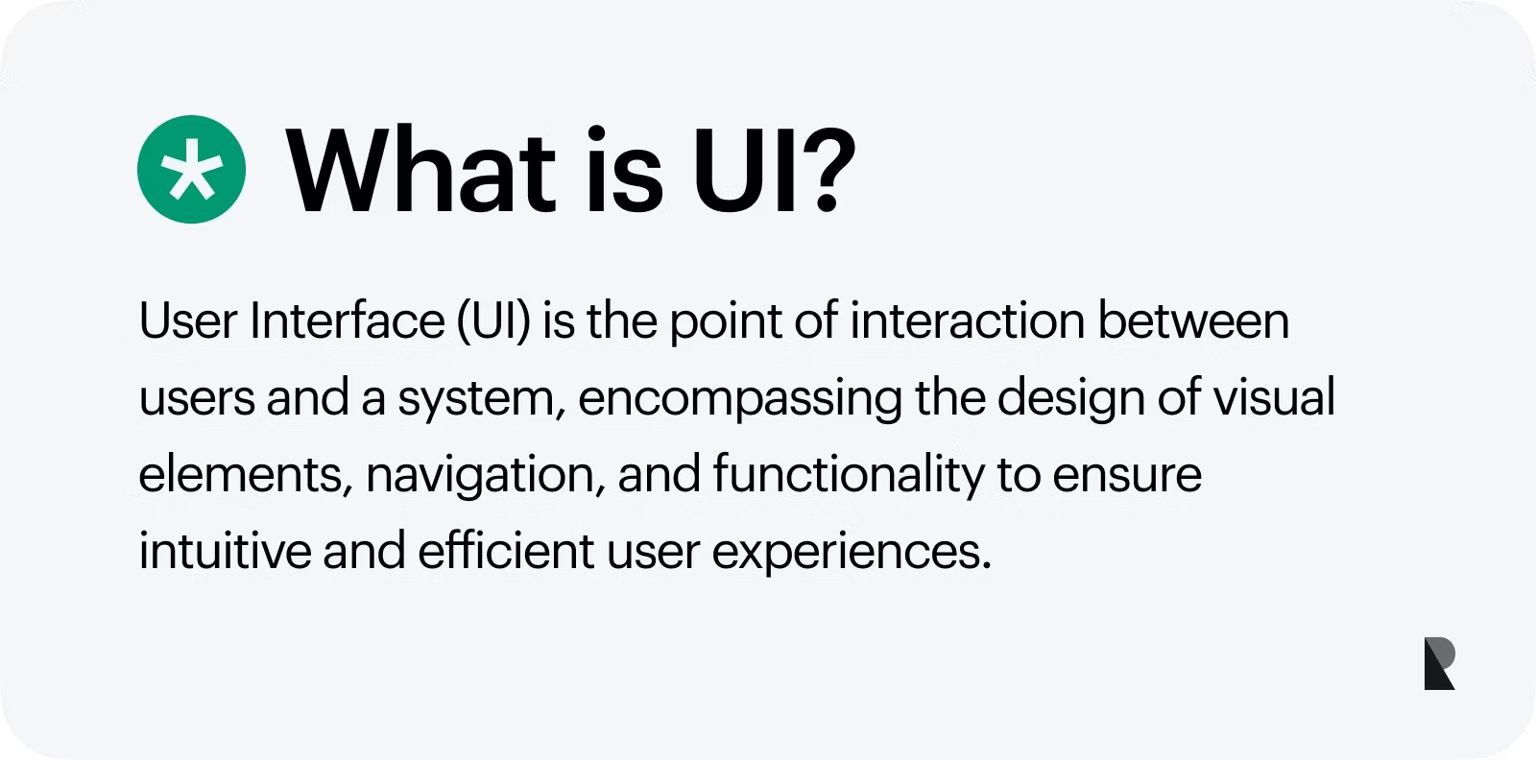
About user interface

Slide 4
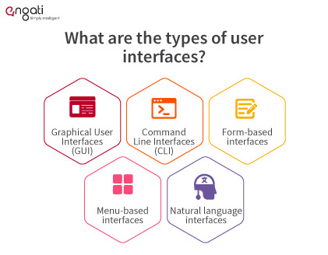

Slide 5

About user experience

Slide 6
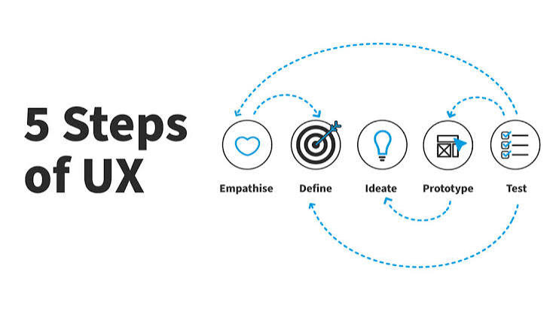
Important steps

Slide 7


Slide 8

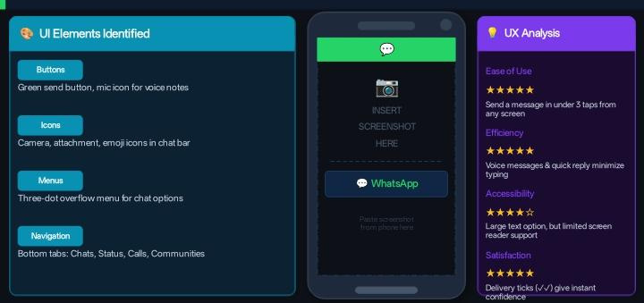
whatsapp

Slide 9

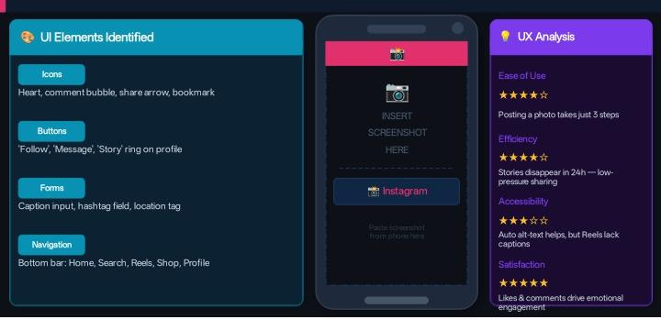
Instagram

Slide 10

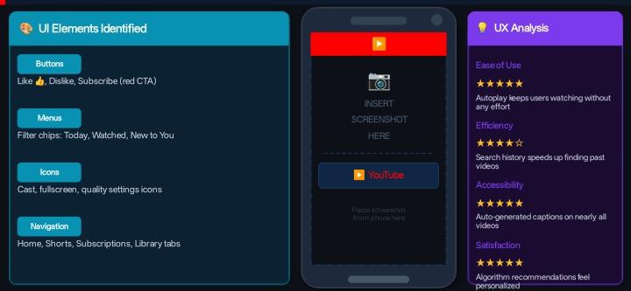

Slide 11

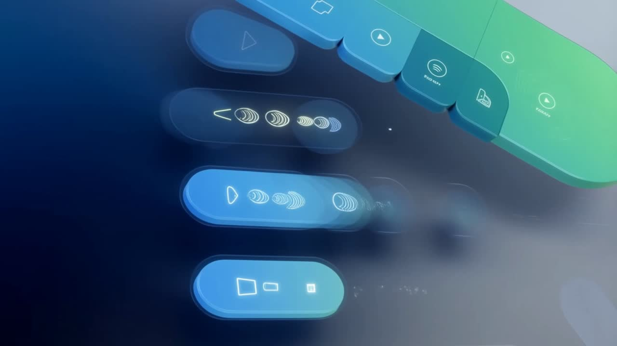

Slide 12

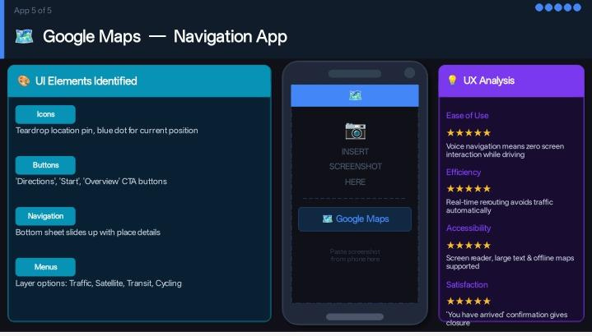

Slide 13
THANK YOU😊❤️

